Slide 1
CS 416 Web Programming AJAX
Dr. Williams
Central Connecticut State University

Slide 2
Input revisited – it’s magic!
Once of the input types we didn’t touch upon earlier was hidden input
<input type="hidden" name="name" value="Chad"/>
Form element doesn’t show up on page but value of element gets submitted with rest of form
Why do I care?
Very useful for keeping track of identifier (or other info) without having to show it to the user!

Slide 3
Topics for Lecture
What is AJAX
Walkthrough of making a server based dynamic page

Slide 4
What is AJAX
Asynchronous JavaScript Technology
It allows web pages to be dynamic based on server content
This is accomplished through using Javascript to make a connection to the server and rewriting portions of the page based on the response
Based on internet standards so works across browsers and platforms

Slide 5
Some of its uses
Real-time form validation
Checking serial numbers, zip codes, credit card validity
Autocompletion
As the user types suggesting possible completions or useful completions
Load on demand
Load portions of the page as they get downloaded (ex. Google maps)

Slide 6
More uses
Rich user interface controls
Dynamically loaded trees, data tables, progress bars
Refreshing data and server push
Live update of scores, stock ticker
Page as an application
Create a single page as an application

Slide 7
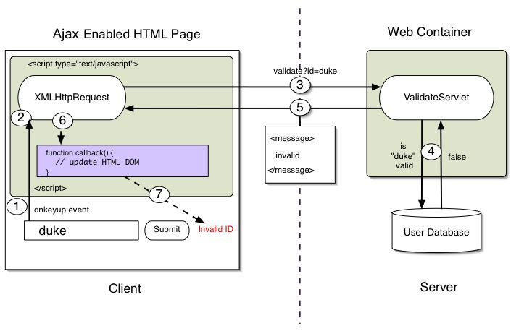
AJAX flow

Slide 8
XMLHttpRequest
The keystone of AJAX is the XMLHttpRequest object
This object is used to establish connection to server
Exchange data with the server
Allows update of parts of page without reloading

Slide 9
Creating XMLHttpRequest
var xmlhttp;
if (window.XMLHttpRequest){
// code for IE7+, Firefox, Chrome, Opera, Safari
xmlhttp=new XMLHttpRequest();
}else{
xmlhttp=new ActiveXObject("Microsoft.XMLHTTP");
}

Slide 10
Sending a request
xmlhttp.open("GET","ajax_info.txt",true); xmlhttp.send();
Method | Description
open(method,url,async) | Specifies the type of request, the URL, and if the request should be handled asynchronously or not. method: the type of request: GET or POST url: the location of the file on the server async: true (asynchronous) or false (synchronous)
send(string) | Sends the request off to the server. string: Only used for POST requests

Slide 11
HTTP Get vs. Post
For GET the URL is built by combining the parameters in the same way they appear for a form’s GET
MyServlet?loginId=chad&password=pass
encodeURIComponent function helps encode special characters “Chad & Patti” get encoded to “Chad+%26+Patti”
var url = “MyServlet?id=" + encodeURIComponent(idField.value);
xmlhttp.open("GET","demo_get2.asp?fname=Henry&lname=Ford",true); xmlhttp.send();
Should not be used if cached page will not work or changing data on the server

Slide 12
POST
Similar to GET, but must set request header and rather than send being empty, request parameters placed in send
xmlhttp.open("POST","ajax_test.asp",true);
xmlhttp.setRequestHeader("Content-type",
"application/x-www-form-urlencoded");
xmlhttp.send("fname=Henry&lname=Ford");

Slide 13
Server response
Property | Description
xmlhttp.responseText | get the response data as a string
xmlhttp.responseXML | get the response data as XML data
With response text, server can send back any text to be processed and placed on the form.
With response xml, response is read using XML DOM model
document.getElementById("myDiv").innerHTML=xmlhttp.responseText;

Slide 14
onreadystatechange event
When a request is sent to the server the xmlhttp receives events relating to the status of the response
To use it you specify a function to assign to the event
The xmlhttp will then call that function every time the ready state changes

Slide 15
Ready state
readyState | Holds the status of the XMLHttpRequest. Changes from 0 to 4: 0: request not initialized 1: server connection established 2: request received 3: processing request 4: request finished and response is ready
status | 200: "OK" 404: Page not found
xmlhttp.onreadystatechange=function() { if (xmlhttp.readyState==4 &&
xmlhttp.status==200){ document.getElementById("myDiv").innerHTML=
xmlhttp.responseText; } }

Slide 16
Acting on user entry
Respond to any javascript event on the webpage and call a javascript function to retrieve content
Walkthrough of AJAXTable
Walkthrough AJAXAddition
<input type=“text” id=“userid” name=“id” onkeyup=“validate();”/>

Slide 17
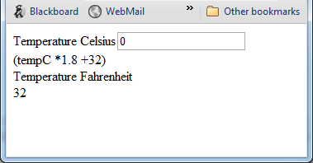
AJAX Temperature conversion
You are given the shell of the page (AJAXTempConversion.html)
Complete page
Create Servlet

Slide 18
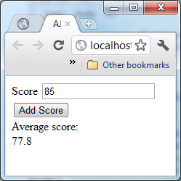
Review from last class
Create a page/servlet to return the average of all scores added via AJAX (there is a shell of the HTML named AJAXAverage)
Behavior is every time the user clicks Add Score the new average is output to the page

Slide 19
Topics for Lecture
Structured content
Creating structured content
Processing XML

Slide 20
XML responses
Often times a response from a server will be an xml document rather than plain text
Allows structured content, allowing the page to determine what to show
On server side this may be a static XML document, a document built from database results, or content built that is specific to that call
Key aspect is the page decides format rather than the server
More flexible display

Slide 21
XML responses
Why XML response?
Page decides format rather than the server
In general it is better to have display logic on server, but there are exceptions
Very useful if building shared service
Consider a feed of sports scores from the NFL to all news carriers
NFL builds single interface and XML response
News carriers specify how to handle the XML individually

Slide 22
XML document
Root
<CATALOG>
<CD>
<TITLE>War</TITLE>
<ARTIST>U2</ARTIST>
</CD>
<CD>
<TITLE>Wasting Light<TITLE>
<ARTIST>Foo Fighters<ARTIST>
</CD>
</CATALOG>
Child Elements
Child Elements

Slide 23
CD library service
AJAXCDArtistsTitle.html
AJAXCDSecondClient.html

Slide 24
XML document design
Guidelines:
Cross between object model and data model
If there is a 0-1/1-1 relationship the tag should be directly on the object (ex. TITLE)
If there is a 0-many there should be a tag labeling the collection then repeated tag inside (ex. CATALOG/CD and TRACKS/TRACK)
<CATALOG>
<CD>
<TITLE>War</TITLE>
<ARTIST>U2</ARTIST>
</CD>
<CD>
<TITLE>Wasting Light</TITLE>
<ARTIST>Foo Fighters</ARTIST>
<TRACKS>
<TRACK>Bridge Burning</TRACK>
<TRACK>Rope</TRACK>
</TRACKS>
</CD>
</CATALOG>

Slide 25
Creating XML phone book service
Design the XML structure to return the following
Multiple people
Each person has a name, city, state and zero to many work phone numbers AND zero to many personal phone numbers
Create an example return document
How might the XML structure change if each phone number had a description as well?

Slide 26
XML syntax
With Document Object Model(DOM) you are able to specify retrieving nodes or tags within the XML
The root of the document (the tag which hold everything in the XML) can be retrieved using
rootNode=xmlhttp.responseXML.documentElement
With that element portions of the XML document can be retrieved by knowing what tags you are interested in

Slide 27
Accessing child elements
Any child elements can be accessed by specifying the name of the tag you want to retrieve
cds = rootNode.getElementsByTagName("CD");
Return will be an array of all elements matching that tag
From that tag element you can access sub tag(s) elements in the same way
titles = cds[0].getElementsByTagName(“TITLE”);

Slide 28
Accessing child elements cont.
Be aware when you access the child elements with getElementsByTagName it will match all child tags with that name not just immediate child tags
<CDs>
<CD>
<ARTIST>Bob Dylan</ARTIST>
</CD>
<CD>
<ARTIST>Nine Inch Nails</ARTIST>
</CD>
</CDs>

Slide 29
Accessing Tag value
Once you have the tag you want the value of (ex. TITLE) you access the node value of that tag
value = titles[0].firstChild.nodeValue
By doing this structured data can be read from the response rather than just text

Slide 30
Printing CD Info
Print the Artist and Title in a table

Slide 31
Printing Street and State
Using the StudentInfo.xml output the street and state

Slide 32
Creating structured results
Creating structured results is very useful when returning complex information often such as multiple results
In creating the results you essentially use the servlet to build your xml file
Ex. StudentGradesServlet, AJAXFindByNameServlet

Slide 33
XML phone book service revisited
Using XML designed before…
Write psuedo code for javascript side to output in this format with only the personal phone numbers printed:
Bob – New Britain, CT
860-867-5309
888-345-1234
Charles – Hamden, CT
280-112-3581

Slide 34
Student grades
Step1: Create web page that looks like the previous ones, where you click to get student grades
Call the StudentGradesServlet to get the XML and display the student names and grades
Step2: Update your page so that there is a text box where the user can type characters
Modify the servlet so that the characters entered will filter so only names that begin with the characters entered will be returned
Step 3: Make it so you can add new names and grades on your page

